Slide 1


EAST WEST COLLEGE OF ENGINEERING
BACHELOR OF ENGINEERING
IN
COMPUTER SCIENCE AND ENGINEERING
MINI PROJECT REVIEW (21CSMP67)
on
FACE RECOGNITION BASED ATTENDENCE SYSTEM
SUBMITTED BY
GUIDED BY
HARSHITHA S (1EE21CS019)
MEGHANA K V (1EE21CS029)
PRIYANKA H (1EE21CS039)
RAMYA B (1EE21CS040)
PROF. GNANAMANI H
ASSISTANT PROF
DEPT. OF CSE

Slide 2

contents
Abstract
Problem statement
introduction
Literature survey
Objective & scope
Requirements
System architecture
Methodology
Test cases
Results
Conclusion
Future work
references

Slide 3

Abstract
This project presents a face recognition-based attendance system that automates and enhances the accuracy of attendance recording. Utilizing a camera and advanced facial recognition algorithms.
The system minimizes proxy attendance, reduces administrative effort, and is suitable for educational institutions and corporate environments. Its user-friendly, scalable, and secure design makes it an effective solution for modern attendance management.

Slide 4

Problem statement
The Traditional Method Of Taking Attendance Has A Major Drawback In That It Necessitates A Lot Of Time-consuming, Ineffective Human Interaction. The Solution To These Problems Lies In The Creation Of Intelligent And Autonomous Systems That Can Efficiently Record, Manage, And Report Attendance Without The Need For Human Intervention.

Slide 5
introduction
Generally, in the classroom the attendance was taken by the teachers manually at the beginning and ending of the class.
The problem with this approach is that it requires some time to take attendance and the manual process will have chances to make mistakes in most of the cases.
To overcome that problem, RFID (Radio Frequency Identification) was introduced in the past years. But those are also having the fail proof of attendance system. So, we are introducing the concept of Face Recognition Based Student Attendance System.
The main objective of proposed system is to allot attendance to the students using face recognition-based algorithms to achieve fail proof attendance system.

Slide 6
Literature survey
Paper Title | Year of publication | Author name | summary
AUTOMATIC ATTENDANCE MANAGEMENT SYSTEM USING FACE RECOGNITION | 2016 | E.Varadharaja, R.Dharani, S.Jeevitha, B.Kavinmathi S.Hemalatha | Methodology Background Subtraction Face detection and cropping Removes the risk of manual errors Decrease the loss of output Saves time
CLASS ATTENDANCE MANAGEMENT SYSTEM USING FACE RECOGNITION | 2018 | Omar Abdul Rhman, Salim, Rashid Funke, Olanrewaju, Wasim Adebayo Balogun | Methodology Haar Feature-based Cascade algorithm Local Binary Patterns(LBP) Algorithm Decrease the loss of output Saves time

Slide 7
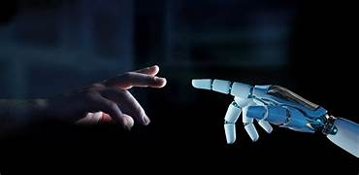
Objective & scope
OBJECTIVES :
To develop a portable Smart Attendance System which is handy and self-powered.
Able to recognize the face of an individual accurately based on the face database.
Allow parents to track their child’s attendance.
Develop a database for the attendance management system.
Provide a user-friendly interface for admins to access the attendance database and for non-admins (parents) to check their child’s attendance by mailing the attendance.
SCOPE :
The main intention of this project is to solve the issues encountered in the old attendance system while reproducing a brand new innovative smart system that can provide convenience to the institution.
Provides facility for the automated attendance of students.
An excel sheet is created which contains the student attendance and is mailed to the respected Parents.

Slide 8


System requirements
HARDWARE REQUIREMENTS
SOFTWARE REQUIRMENTS
Intel Dual Core Processor
500 MB Hard Disk Drive.
128GB RAM.
Keyboard, Mouse
Internet
Computer
Operating System : Windows, Linux
Code Editor : Visual Studio Code
Database : MYSQL
Built with : Python , Tkinter GUI, OpenCV ,
Tkinter GUI
Spreadsheet : Excel

Slide 9
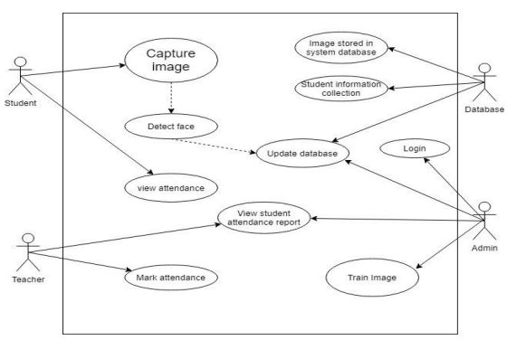
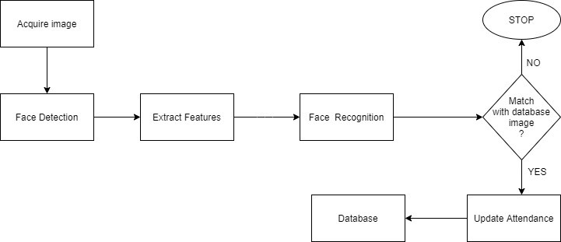
System architecture
USE CASE DIAGRAM :
BLOCK DIAGRAM :

Slide 10
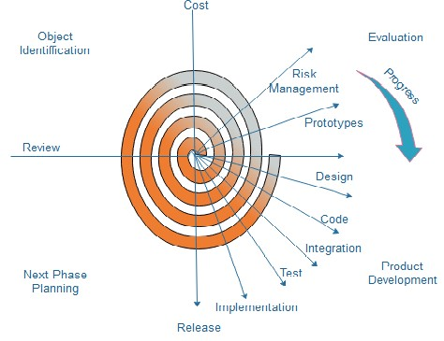
methodology
Spiral Model
is an evolutionary software process model that couples the iterative feature of prototyping with the controlled and systematic aspects of the linear sequential model.
Each cycle in the spiral is divided into four parts:
Objective Setting:
Risk Assessment and reduction:
Development and validation:
Planning:

Slide 11
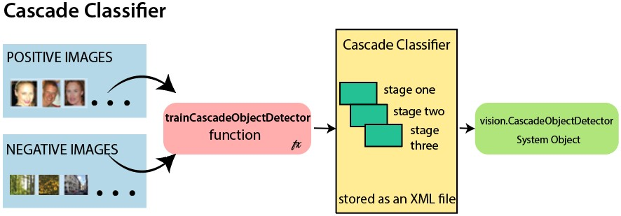
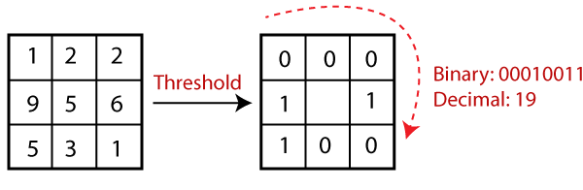
ALGORITHM
HAARCASCADE OPENCV
LBPH OPENCV
It is used in image recognition and image processing that is specially designed for pixel data.
It is a simple approach that labels the pixels of the image threshold the neighborhood of each pixel.

Slide 12

Test cases
Test Case 1: Student Face Registration
Objective: Verify that a student's face can be registered successfully.
Expected Result: Student's face data is saved successfully in the database.
Test Case 2: Face Recognition and Attendance Marking
Objective: Verify that the system can recognize a registered face and mark attendance.
Expected Result: The system recognizes the face, marks the attendance, and updates the attendance record.
Test Case 3: Generate Attendance Report
Objective: Verify that the system can generate an attendance report.
Expected Result: The system generates a report and displays it on the screen. The report can be exported as a CSV file.
Test Case 4: Verify Email Sending
Objective: Verify that the Email is sent successfully.
Expected Result: Email must be sent Correctly to corresponding Students List.

Slide 13
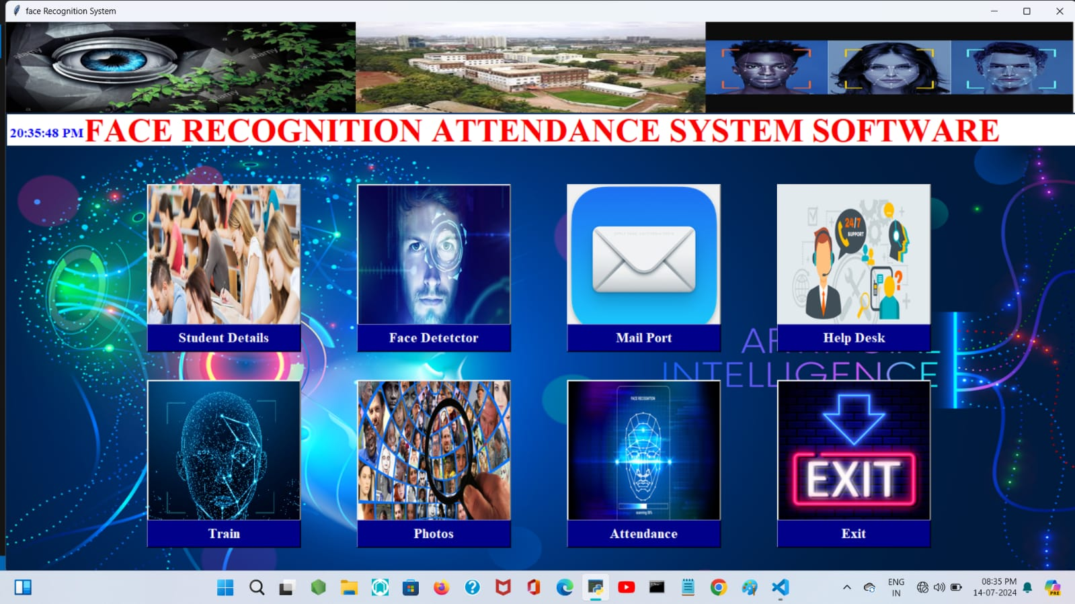
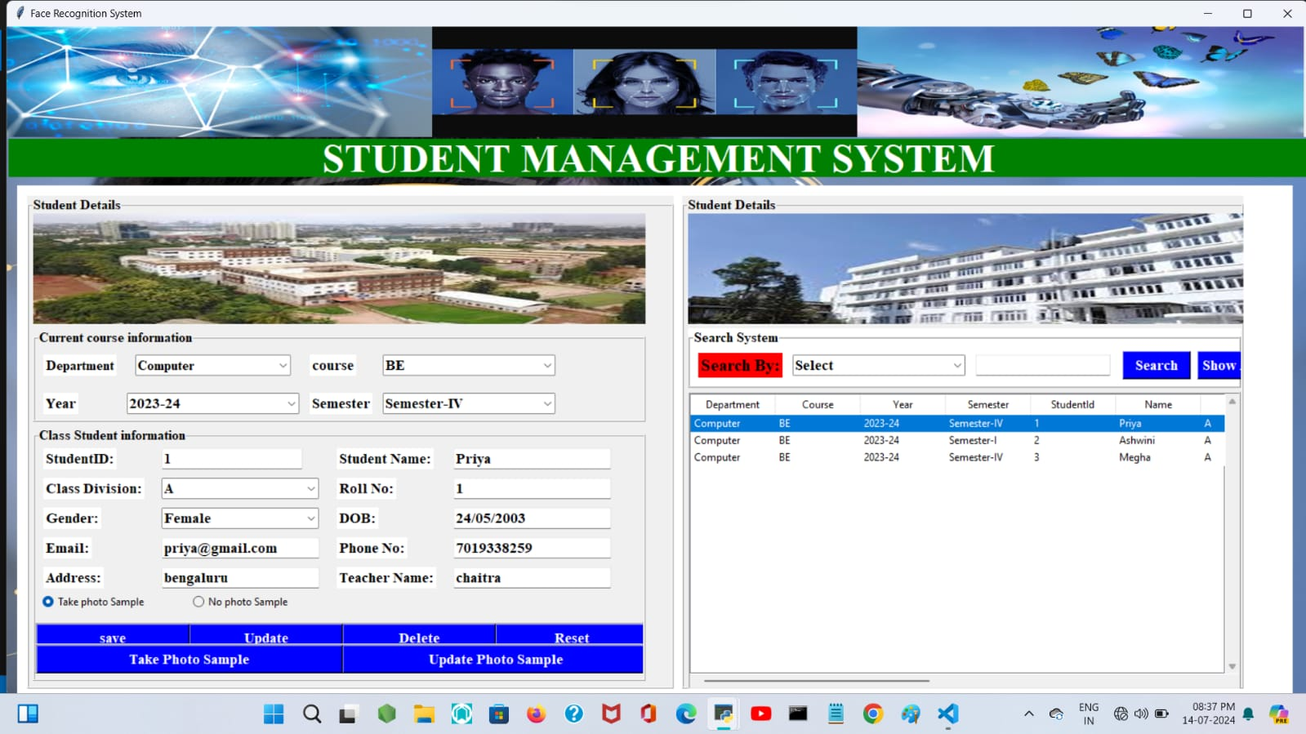
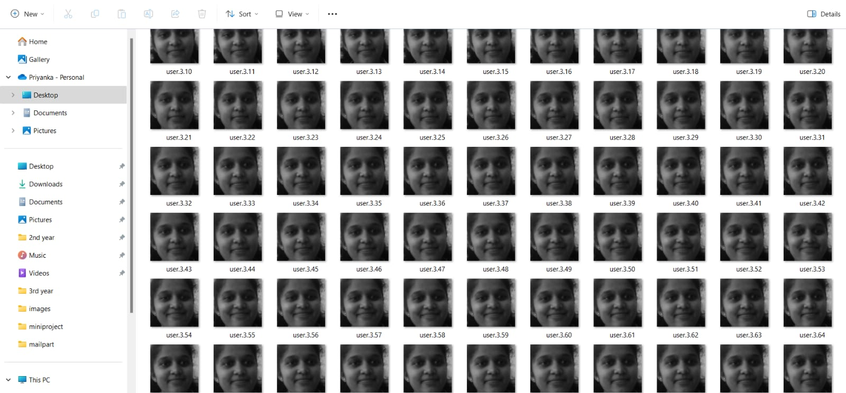
results

Slide 14
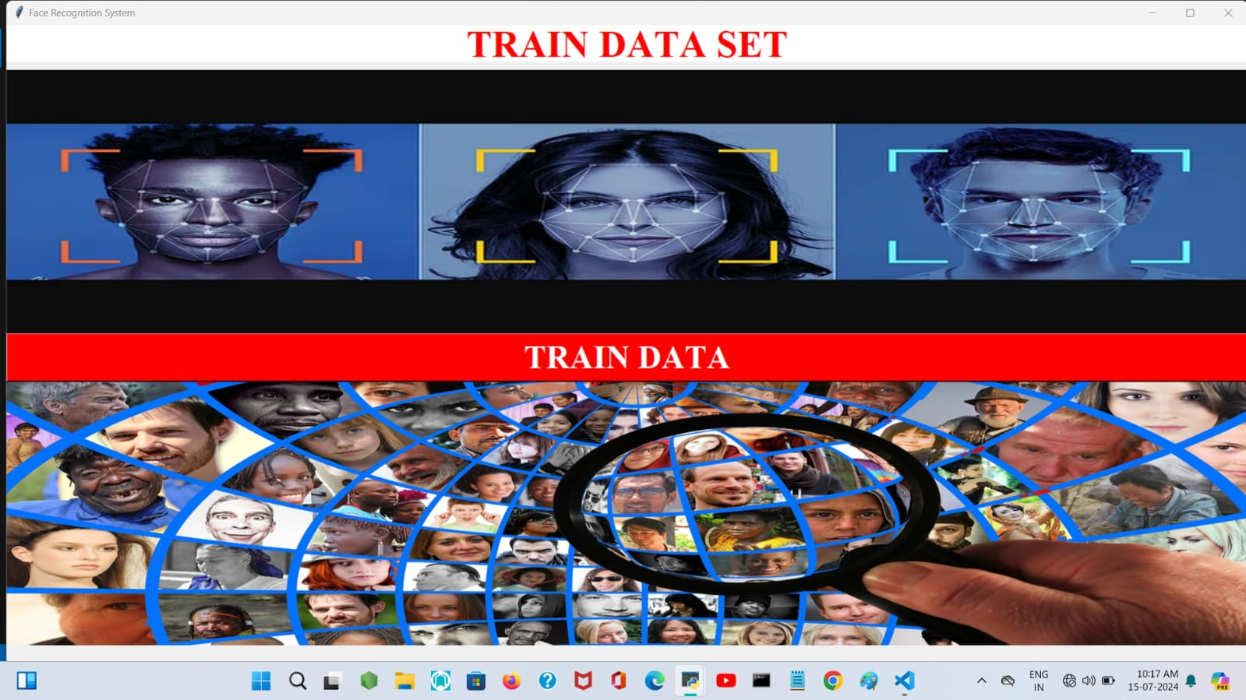
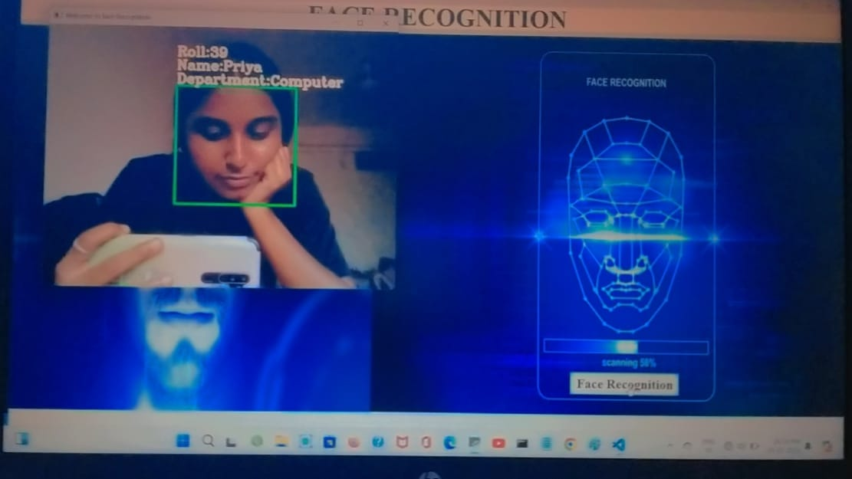
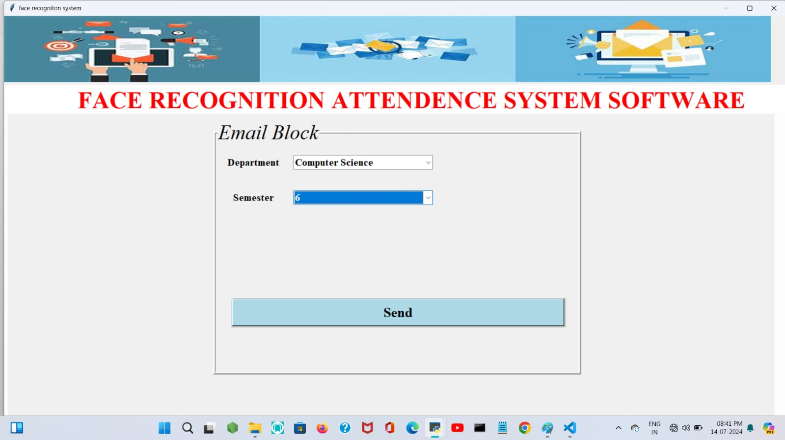
results

Slide 15

conclusion
Enhanced Accuracy: Despite the widespread use of automatic attendance tools, errors persist. Our system uses advanced technology to significantly reduce these errors.
Leveraging OpenCV: Utilizes OpenCV, a Python open-source library for computer vision, Artificial Intelligence, and Machine Learning. It employs HAAR-Cascade Detection and LBPH algorithm for effective face recognition.
Resource Efficiency: The system saves resources by minimizing human intervention and handling complex tasks related to data storage.
Resolving Traditional Issues: The system addresses the shortcomings of traditional attendance models, providing a more reliable solution.
User Convenience: Offers ease of access to attendance information by generating CSV files, ensuring data is easily retrievable and manageable.

Slide 16

Future enhancement
The number of training images can be reduced by removing duplicate images of the same person, or images with similar embeddings.
The training time can be reduced by retraining the classifier only for the newly added images.
A feature which can give intruder alert can be included in the system.
Wrongly classified images can be added to the training dataset with the correct label so as to increase the accuracy of the recognition model.

Slide 17

references
“Smart Attendance Management and Analysis with Signature Verification”(Hardika Chauhan, Chitaliya Nehal,2017)
“Automatic Attendance Management System Using Face Recognition”(E.Varadharaja, R.Dharani, S.Jeevitha…, 2016)
“Class Attendance Management System Using Face Recognition”(Omar Abdul Rhman, Salim,...., 2018)

Slide 18


Any questions??

Slide 19


thankyou

